Slide 1

ESS ELL SOURCING CO.

Slide 2
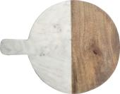
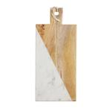
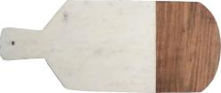
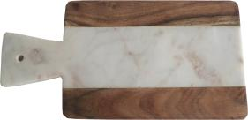
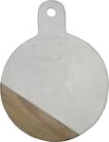

STYLE # : CB 109
MATERIAL : WHITE MARBLE & ACACIA WOOD
SIZE ( INCHS ) : 15 X 12
STYLE # : CB 112
MATERIAL : WHITE MARBLE & ACACIA WOOD
SIZE ( INCHS ) : 17 X 8
STYLE # : CB 192
MATERIAL : WHITE MARBLE & MANGO WOOD
SIZE ( INCHS ) : 20 X 7
STYLE # : CB 196
MATERIAL : WHITE MARBLE & ACACIA WOOD
SIZE ( INCHS ) : 12 X 6
PRICE :
STYLE # : CB 201
MATERIAL : WHITE MARBLE & ACACIA WOOD
SIZE ( INCHS ) : 18 X 7
STYLE # : CB 204
MATERIAL : WHITE MARBLE & ACACIA WOOD
SIZE ( INCHS ) : 15 X 12

Slide 3
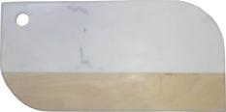
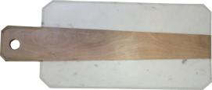
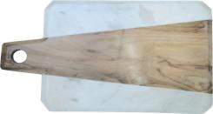
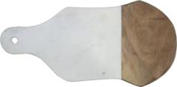
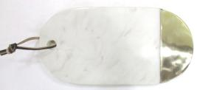
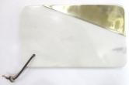
STYLE # : CB 205
MATERIAL : WHITE MARBLE & MANGO WOOD
SIZE ( INCHS ) : 18 X 9
STYLE # : CB 207
MATERIAL : WHITE MARBLE & ACACIA WOOD
SIZE ( INCHS ) : 21 X 9
STYLE # : CB 208
MATERIAL : WHITE MARBLE & ACACIA WOOD
SIZE ( INCHS ) : 14 X 9
STYLE # : CB 210
MATERIAL : WHITE MARBLE & ACACIA WOOD
SIZE ( INCHS ) : 18 X 9
STYLE # : CB 359
MATERIAL : WHITE MARBLE & BRASS
SIZE ( INCHS ) : 12 X 6
STYLE # : CB 357
MATERIAL : WHITE MARBLE & BRASS
SIZE ( INCHS ) : 12 X 7

Slide 4

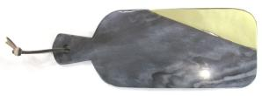

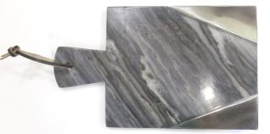
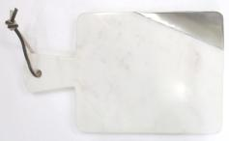
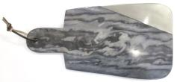
STYLE # : CB 361
MATERIAL : GREY MARBLE & BRASS
SIZE ( INCHS ) : 12 X 6
STYLE # : CB 360
MATERIAL : GREY MARBLE & BRASS
SIZE ( INCHS ) : 15 X 6
STYLE # : CB 366
MATERIAL : WHITE MARBLE & STAINLESS STEEL
SIZE ( INCHS ) : 15 X 6
STYLE # : CB 364
MATERIAL : WHITE MARBLE & STAINLESS STEEL
SIZE ( INCHS ) : 14 X 8
STYLE # : CB 371
MATERIAL : GREY MARBLE & STAINLESS STEEL
SIZE ( INCHS ) : 14 X 8
STYLE # : CB 372
MATERIAL : GREY MARBLE & STAINLESS STEEL
SIZE ( INCHS ) : 16 X 8

Slide 5
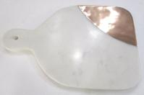
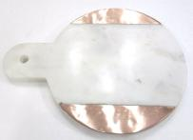
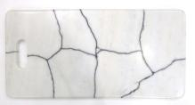
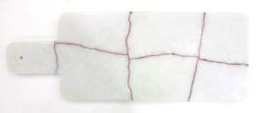
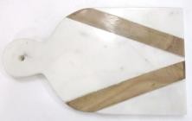
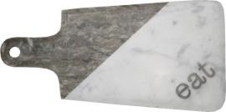
STYLE # : CB 389
MATERIAL : WHITE MARBLE & COPPER
SIZE ( INCHS ) : 12 X 9
STYLE # : CB 388
MATERIAL : WHITE MARBLE & COPPER
SIZE ( INCHS ) : 12 X 9
STYLE # : CB 381
MATERIAL : WHITE MARBLE
SIZE ( INCHS ) : 18 X 9
STYLE # : CB 377
MATERIAL : WHITE MARBLE
SIZE ( INCHS ) : 15 X 6
STYLE # : CB 390
MATERIAL : WHITE MARBLE & ACACIA WOOD
SIZE ( INCHS ) : 12 X 9
STYLE # : CB 224
MATERIAL : WHITE & BROWN GALAXY MARBLE WITH METAL INLAY
SIZE ( INCHS ) : 16 X 8

Slide 6
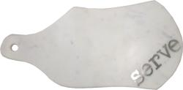
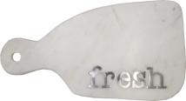

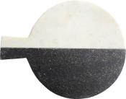
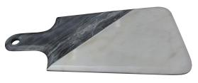

STYLE # : CB 229
MATERIAL : WHITE MARBLE WITH METAL INLAY
SIZE ( INCHS ) : 18 X 9
STYLE # : CB 226
MATERIAL : WHITE MARBLE WITH METAL INLAY
SIZE ( INCHS ) : 15 X 8
STYLE # : CB 133
MATERIAL : WHITE & BLACK SPARKLE MARBLE
SIZE ( INCHS ) : 18 X 7
STYLE # : CB 136
MATERIAL : WHITE & BLACK SPARKLE MARBLE
SIZE ( INCHS ) : 15 X 12
STYLE # : CB 182
MATERIAL : WHITE & BROWN GALAXY MARBLE
SIZE ( INCHS ) : 20 X 7
STYLE # : CB 184
MATERIAL : WHITE & GREY MARBLE
SIZE ( INCHS ) : 16 X 8

Slide 7
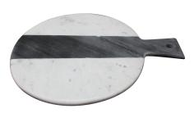
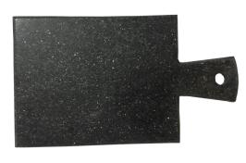
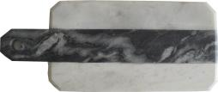
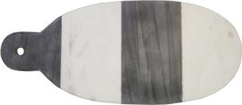
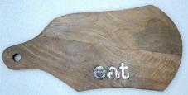
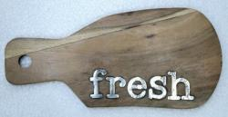
STYLE # : CB 186
MATERIAL : WHITE & GREY MARBLE
SIZE ( INCHS ) : 15 X 12
STYLE # : CB 198
MATERIAL : BLACK SPARKLE MARBLE
SIZE ( INCHS ) : 14 X 8
STYLE # : CB 188
MATERIAL : WHITE & GREY MARBLE
SIZE ( INCHS ) : 17 X 7
STYLE # : CB 213
MATERIAL : WHITE & GREY MARBLE
SIZE ( INCHS ) : 18 X 8
STYLE # : CB 237
MATERIAL : ACACIA WOOD WITH METAL INLAY
SIZE ( INCHS ) : 18 X 9
STYLE # : CB 239
MATERIAL : ACACIA WOOD WITH METAL INLAY
SIZE ( INCHS ) : 13 X 6

