Slide 1

ESS ELL SOURCING CO.

Slide 2
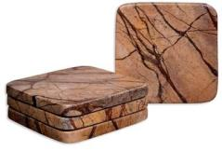
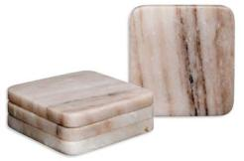
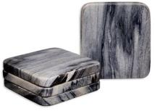
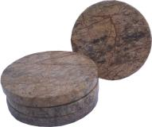
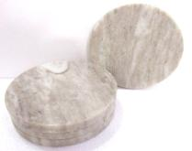
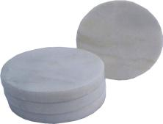

Item# CS 126
Description- S/4 ROUND CORNER COASTER
Size(inches)- 4 X 4
Material- BROWN FOREST MARBLE
Special remarks, if any
Item# CS 127
Description- S/4 ROUND CORNER COASTER
Size(inches)- 4 X 4
Material- BROWN GALAXY MARBLE
Special remarks, if any
Item# CS 128
Description- S/4 ROUND CORNER COASTER
Size(inches)- 4 X 4
Material- GREY MARBLE
Special remarks, if any
Item# CS 132
Description- S/4 ROUND COASTER
Size(inches)- 4 X 4
Material- BROWN FOREST MARBLE
Special remarks, if any
Item# CS 131
Description- S/4 ROUND COASTER
Size(inches)- 4 X 4
Material- BROWN GALAXY MARBLE
Special remarks, if any
Item# CS 130
Description- S/4 ROUND COASTER
Size(inches)- 4 X 4
Material- WHITE MARBLE
Special remarks, if any

Slide 3
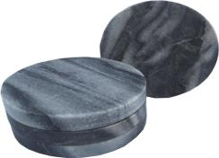
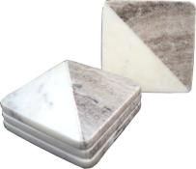
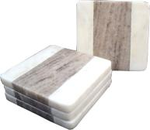
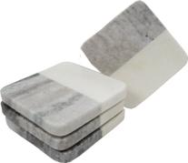
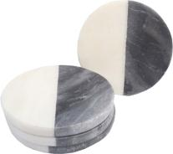
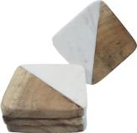
Item# CS 137
Description- S/4 COASTER
Size(inches)- 4 X 4
Material- WHITE & BROWN GALAXY MARBLE
PRICE -:
Special remarks, if any
Item# CS 133
Description- S/4 ROUND COASTER
Size(inches)- 4 X 4
Material- GREY MARBLE
Special remarks, if any
Item# CS 136
Description- S/4 COASTER
Size(inches)- 4 X 4
Material- WHITE & BROWN GALAXY MARBLE
Special remarks, if any
Item# CS 138
Description- S/4 COASTER
Size(inches)- 4 X 4
Material- WHITE MARBLE & ACACIA WOOD
Special remarks, if any
Item# CS 145
Description- S/4 COASTER
Size(inches)- 4 X 4
Material- WHITE & BRWON GALAXY MARBLE
Special remarks, if any
Item# CS 107
Description- S/4 COASTER
Size(inches)- 4 X 4
Material- WHITE & GREY MARBLE
Special remarks, if any

Slide 4
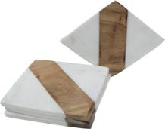
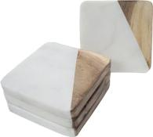
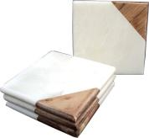
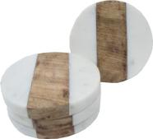
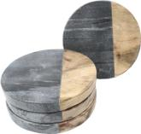
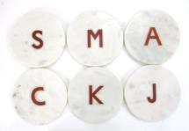
Item# CS 140
Description- S/4 COASTER
Size(inches)- 4 X 4
Material- WHITE MARBLE & ACACIA WOOD
Special remarks, if any
Item# CS 142
Description- S/4 COASTER
Size(inches)- 4 X 4
Material- WHITE MARBLE & ACACIA WOOD
Special remarks, if any
Item# CS 106
Description- S/4 COASTER
Size(inches)- 4 X 4
Material- WHITE MARBLE & ACACIA WOOD
Special remarks, if any
Item# CS 143
Description- S/4 COASTER
Size(inches)- 4 X 4
Material- WHITE MARBLE & ACACIA WOOD
Special remarks, if any
Item# CS 144
Description- S/4 COASTER
Size(inches)- 4 X 4
Material- GREY MARBLE & MANGO WOOD
Special remarks, if any
Item# CS 267
Description- S/4 COASTER WITH INLAY
Size(inches)- 4 X 4
Material- WHITE MARBLE
Special remarks, if any

Slide 5
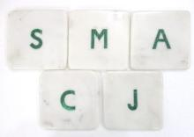
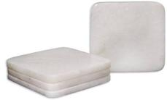
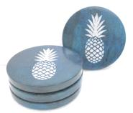
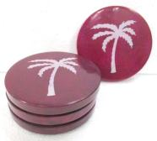
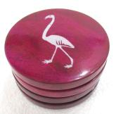
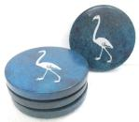
Item# CS 129
Description- S/4 COASTER
Size(inches)- 4 X 4
Material- WHITE MARBLE
PRICE -:
Special remarks, if any
Item# CS 269
Description- S/4 COASTER WITH INLAY
Size(inches)- 4 X 4
Material- WHITE MARBLE
Special remarks, if any
Item# CS 176
Description- S/4 COASTER WITH PINEAPPLE ETCHING
Size(inches)- 4 X 4
Material- TURQUOISE COLOR SOAP STONE
Special remarks, if any
Item# CS 185
Description- S/4 COASTER WITH FLEMINGO ETCHING
Size(inches)- 4 X 4
Material- TURQUOISE COLOR SOAP STONE
Special remarks, if any
Item# CS 177
Description- S/4 COASTER WITH PALM TREE ETCHING
Size(inches)- 4 X 4
Material- PINK COLOR SOAP STONE
Special remarks, if any
Item# CS 182
Description- S/4 COASTER WITH FLEMINGO ETCHING
Size(inches)- 4 X 4
Material- PINK COLOR SOAP STONE
Special remarks, if any

Slide 6
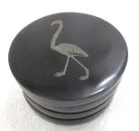
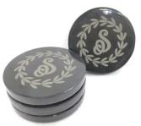
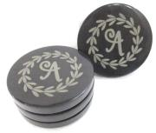
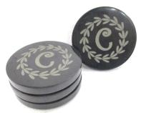
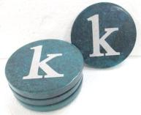
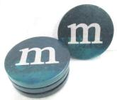
Item# C188
Description- S/4 COASTER WITH FLEMINGO ETCHING
Size(inches)- 4 X 4
Material- BLACK SOAP STONE
Special remarks, if any
Item# CS 190 S
Description- S/4 COASTER WITH ETCHING
Size(inches)- 4 X 4
Material- BLACK SOAP STONE
Special remarks, if any
Item# CS 190 A
Description- S/4 COASTER WITH ETCHING
Size(inches)- 4 X 4
Material- BLACK SOAP STONE
Special remarks, if any
Item# CS 191 M
Description- S/4 COASTER WITH ETCHING
Size(inches)- 4 X 4
Material- TURQUOISE COLOR SOAP STONE
Special remarks, if any
Item# CS 190 C
Description- S/4 COASTER WITH ETCHING
Size(inches)- 4 X 4
Material- BLACK SOAP STONE
Special remarks, if any
Item# CS 191 K
Description- S/4 COASTER WITH ETCHING
Size(inches)- 4 X 4
Material- TURQUOISE COLOR SOAP STONE
Special remarks, if any

Slide 7
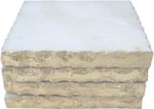
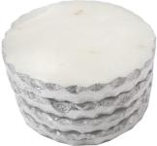
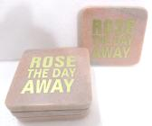
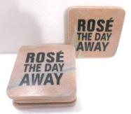
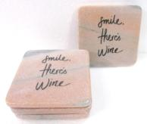
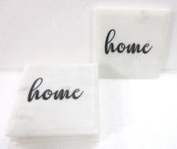
Item# CS 160
Description- S/4 COASTER WITH GOLD EDGES
Size(inches)- 4 X 4
Material- WHITE MARBLE
Special remarks, if any
Item# CS 161
Description- S/4COASTER WITH SILVER EDGES
Size(inches)- 4 X 4
Material- WHITE MARBLE
Special remarks, if any
Item# CS 231
Description- S/4 ROUND EDGE COASTER WITH PRINTING
Size(inches)- 4 X 4
Material- PINK MARBLE
Special remarks, if any
Item# CS 232
Description- S/4 ROUND EDGE COASTER WITH PRINTING
Size(inches)- 4 X 4
Material- PINK MARBLE
Special remarks, if any
Item# CS 236
Description- S/4 ROUND EDGE COASTER WITH PRINTING
Size(inches)- 4 X 4
Material- PINK MARBLE
Special remarks, if any
Item# CS 237
Description- S/4 ROUND EDGE COASTER WITH PRINTING
Size(inches)- 4 X 4
Material- WHITE MARBLE
Special remarks, if any

Slide 8
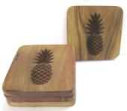
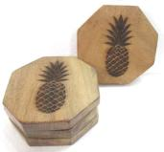
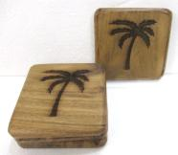
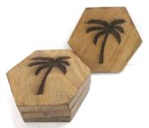
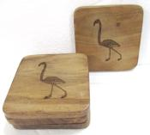
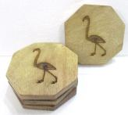
Item# CS 199
Description- S/4 ROUND CORNER COASTER WITH PINE APPLE ETCHING
Size(inches)- 4 X 4
Material- ACACIA WOOD
Special remarks, if any
Item# CS 201
Description- S/4 OCTAGONAL COASTER WITH PINEAPPLE ETCHING
Size(inches)- 4 X 4
Material- ACACIA WOOD
Special remarks, if any
Item# CS 204
Description- S/4 ROLLED EDGE COASTER WITH PALM TREE ETCHING
Size(inches)- 4 X 4
Material- ACACIA WOOD
Special remarks, if any
Item# CS 206
Description- S/4 HEXAGONAL COASTER WITH PALM TREE ETCHING
Size(inches)- 4 X 4
Material-ACACIA WOOD
Special remarks, if any
Item# CS 207
Description- S/4 ROUND CORNER WITH FLEMINGO ETCHING
Size(inches)- 4 X 4
Material- ACACIA WOOD
Special remarks, if any
Item# CS 209
Description- S/4 OCTAGONAL COASTER WITH FLEMINGO ETCHING
Size(inches)- 4 X 4
Material- ACACIA WOOD
Special remarks, if any

Slide 9
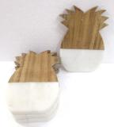
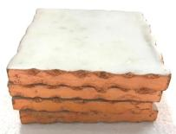
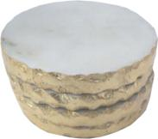
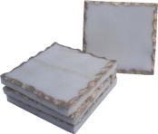
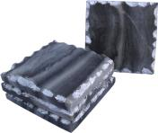
Item# CS 216
Description-S/4 PINEAPPLE COASTER
Size(inches)- 5 X 3.5
Material- WHITE MARBLE & ACACIA WOOD
Special remarks, if any
Item# CS 157
Description-S/4 COASTER WITH COPPER FOIL
Size(inches)- 4 X 4
Material- WHITE MARBLE
Special remarks, if any
Item# CS 162
Description-S/4 COASTER WITH GOLD FOIL
Size(inches)- 4 X 4
Material- WHITE MARBLE
Special remarks, if any
Item# CS 161
Description-S/4 COASTER WITH SILVER FOIL
Size(inches)- 4 X 4
Material- WHITE MARBLE
Special remarks, if any
Item# CS 110
Description-S/4 COASTER WITH GOLD FOIL
Size(inches)- 4 X 4
Material- WHITE MARBLE
Special remarks, if any
Item# CS 115
Description-S/4 COASTER WITH SILVER FOIL
Size(inches)- 4 X 4
Material- GREY MARBLE
Special remarks, if any

