Slide 1

ESS ELL SOURCING CO.

Slide 2
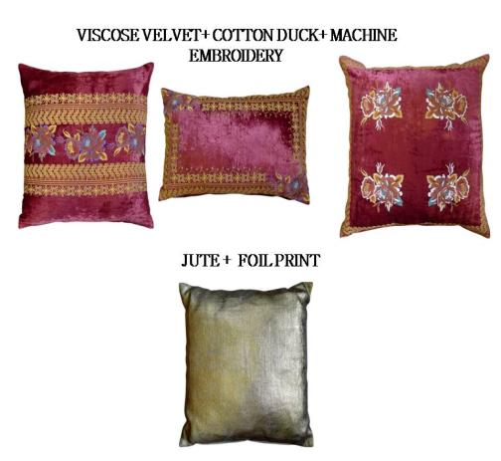
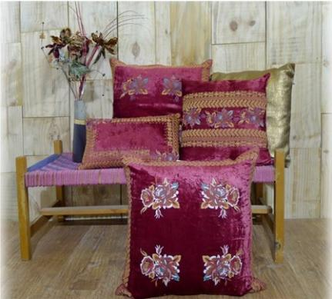
The Royal Collection

Slide 3
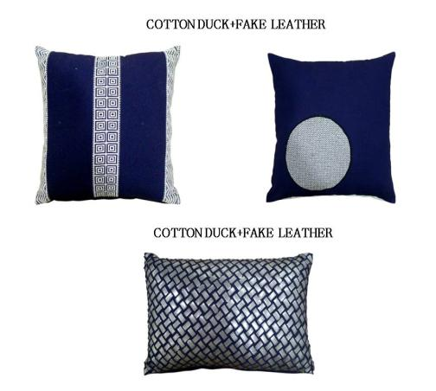
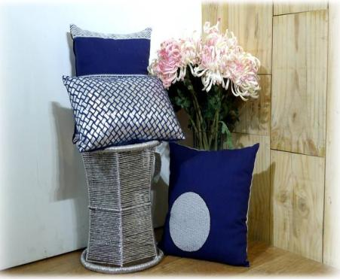
NAVY CROSS

Slide 4
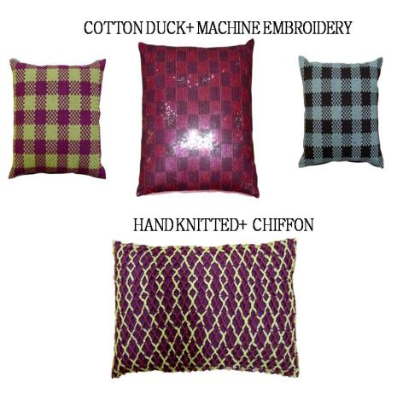
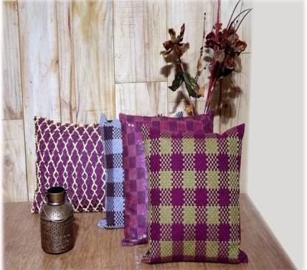
The Basket Collection

Slide 5
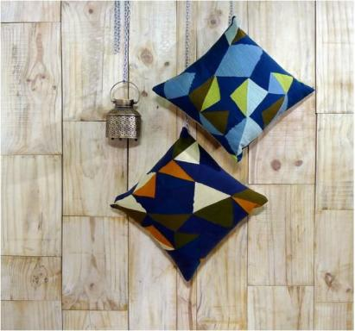
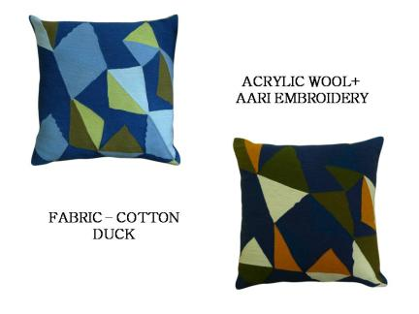
The Triangles

Slide 6
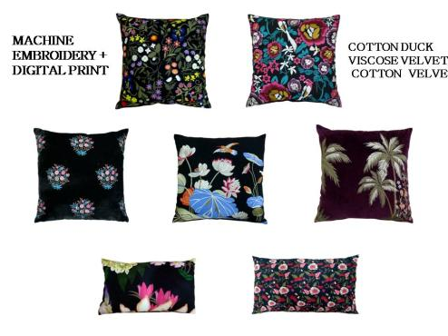
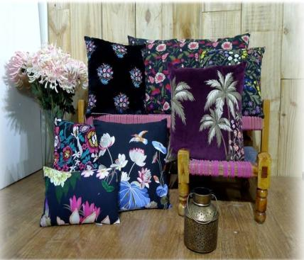
The Garden

Slide 7
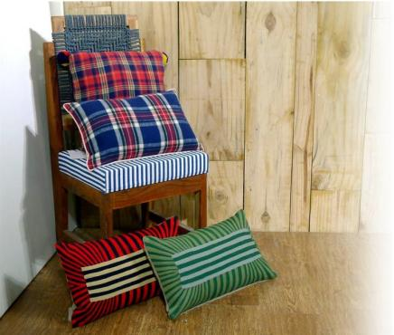
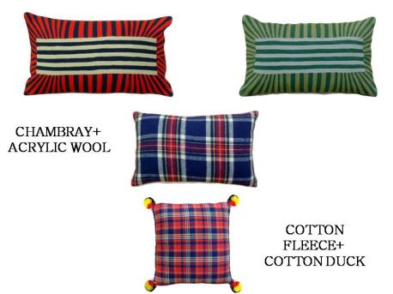
The Strip Days

Slide 8
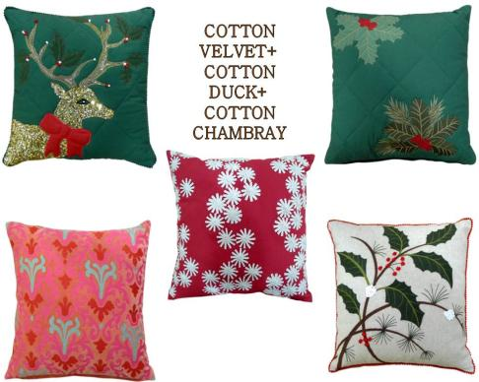
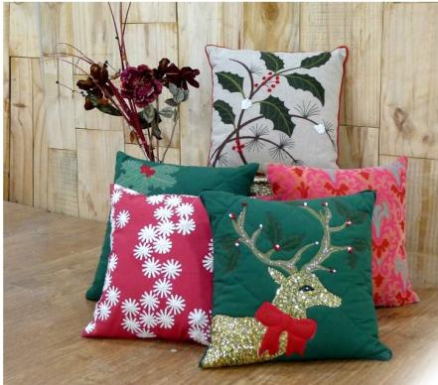
The Christmas Fun

Slide 9
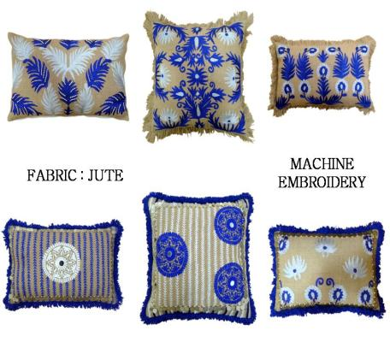
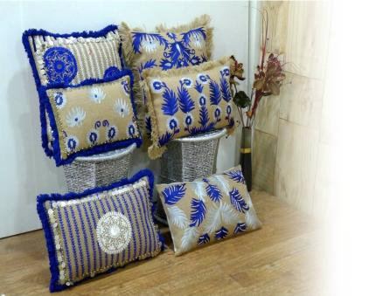
The Beauty Of Nature

Slide 10
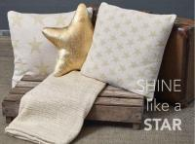
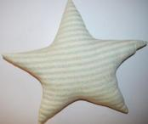
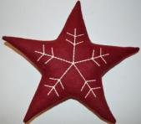

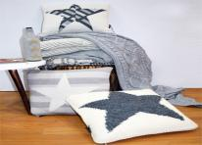


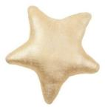
STAR WORK

Slide 11
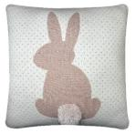
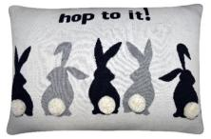
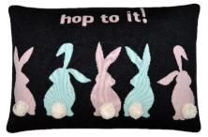
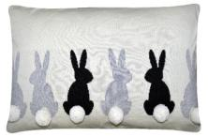
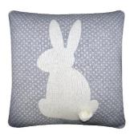
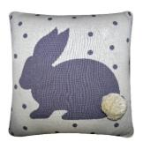
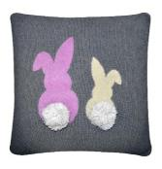
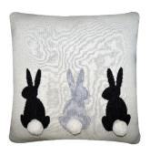
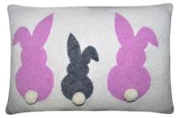
RABBIT WORK

Slide 12
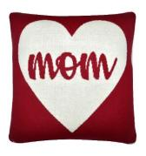


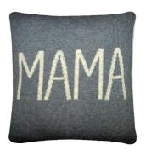
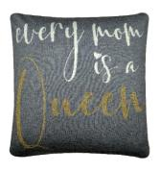
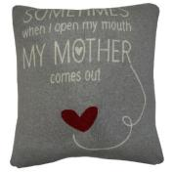


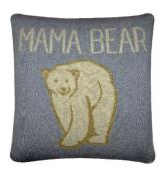

MOTHER’S DAY SPECIAL

Slide 13
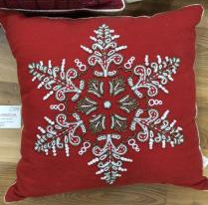
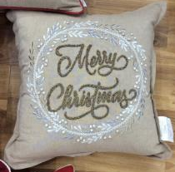
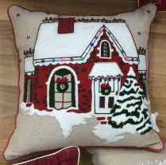
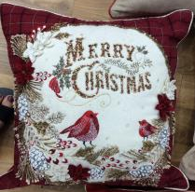
CHRISTMAS SPECIAL

Slide 14
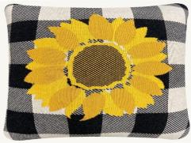
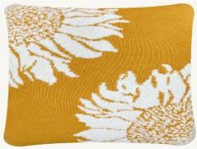
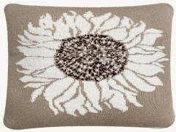
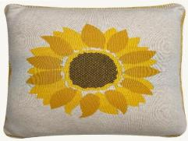
FLOWER PRINT

Slide 15
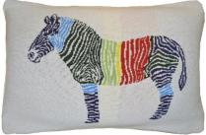
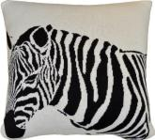
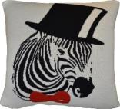
ZEEBRA SPECIAL

Slide 16
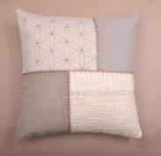
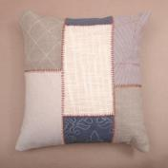
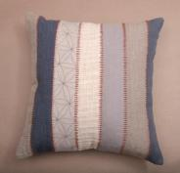
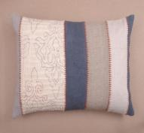




PATCH WORK W EMB CUSHION COVER

Slide 17








WOVEN STRIPE W FRINGE CUSHION

Slide 18








WOVEN STRIPE CUSHION COVER

Slide 19








PRINTED DHURI WODDEN BEADS WORK CUSHION COVER
LINEN CHECK CUSHION COVER

Slide 20








CORD EMBROIDERY CUSHION COVER
Jute tape around

Slide 21








Woven check
Tassels 4 side

Slide 22






Stone washed with embroidery work
Embroidery

Slide 23








QUILTED VELVET CUSHION COVER
Embroidery And Patch Work

Slide 24






PINTEK WORK VELVET CUSHION COVER
CHICKEN EMBROIDERY IN VELVET BASE
CORD EMBROIDERY CUSHION

Slide 25






Hand work embroidery in velvet
Rice stitch embroidery in velvet

Slide 26







Beaded work
PINTEK AND BEADS WORK

Slide 27






Beaded work
PINTEK WORK CUSHION COVER

Slide 28






Acrylic cord hand Matty weave
PATCH WORK EMB CUSHION COVER

Slide 29






Cord with lace work
Crewel embroidery

Slide 30






Chicken embroidery cushion

Slide 31








Crewel embroidery

Slide 32








Crewel embroidery
Chicken and cord embroidery cushion
CHICKEN EMBROIDERY AND BEADS WORK CUSHION
VELEVT PRINT CUSHION COVER

Slide 33








VELEVT PRINT CUSHION COVER
DIGITAL PRINT ON POLY SILK BASE
PRINT ON POLY SILK
PRINT ON POLY SILK BASE

Slide 34








