Slide 1

ESS ELL SOURCING CO.

Slide 2
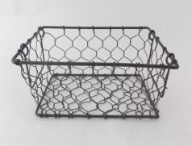
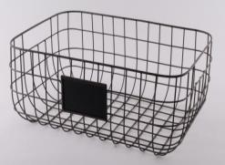
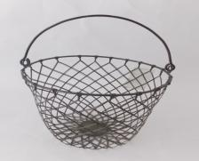
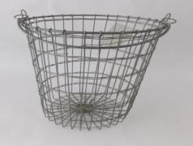
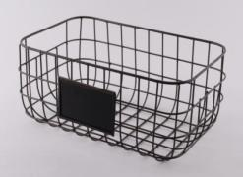
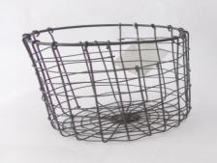
METAL BASKETS

Slide 3
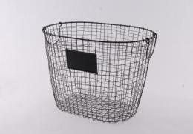
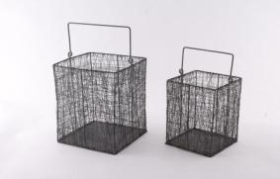
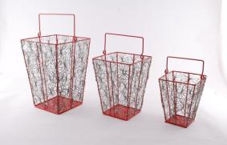
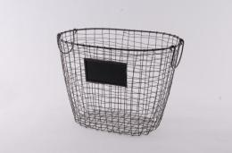
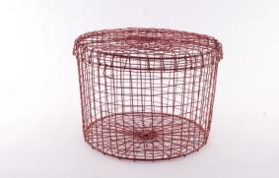
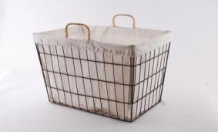
METAL BASKETS

Slide 4
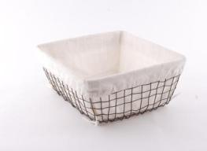
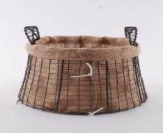
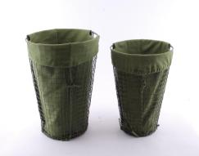
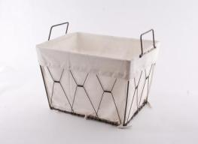
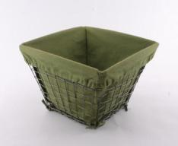
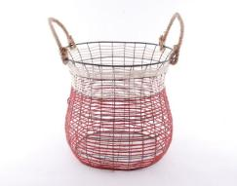
METAL BASKETS

Slide 5
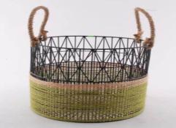
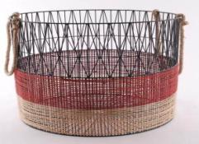
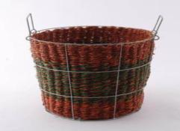
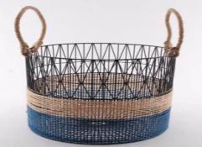
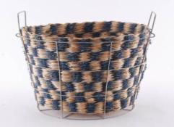
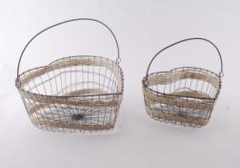
METAL BASKETS

Slide 6
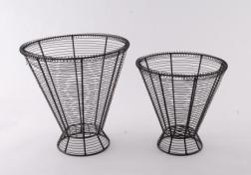
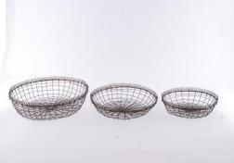
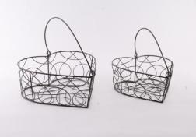
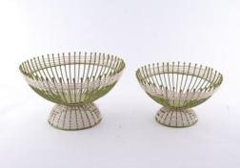
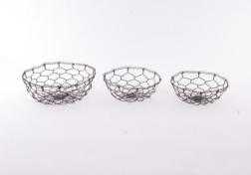
METAL BASKETS

Slide 7
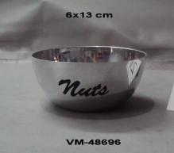
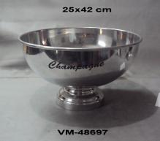
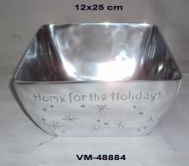
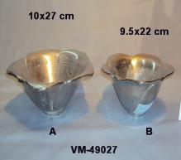
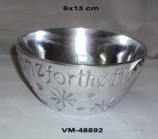
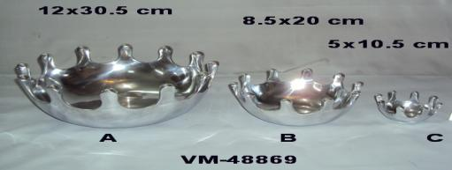
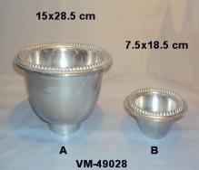
METAL BOWLS

Slide 8
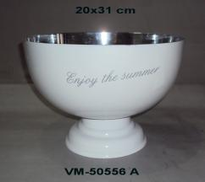
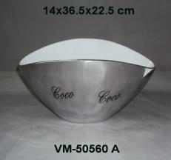
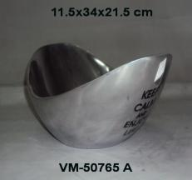
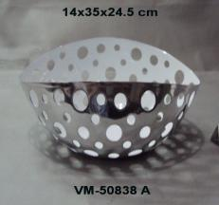
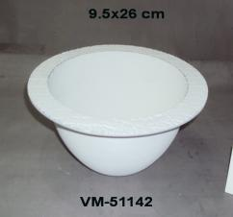
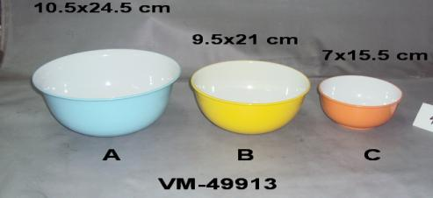
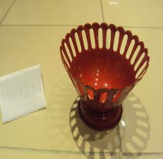
METAL BOWLS

Slide 9
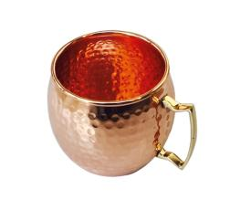
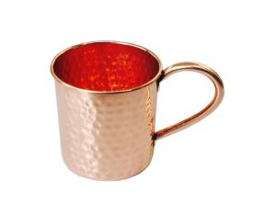
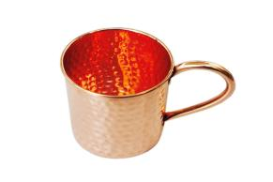
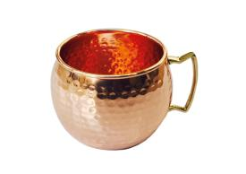
COPPER MUGS

Slide 10
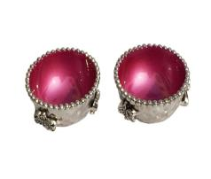
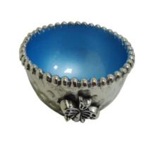
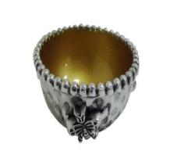





DECORATIVE BOWLS

Slide 11








DECORATIVE CUTLERY

Slide 12








DECORATIVE BOWLS

Slide 13








DECORATIVE SERVING TRAY

Slide 14




NAPKIN RINGS

Slide 15










GARDEN DECORATIVES

Slide 16











DECORATIVE SERVING

Slide 17




DECORATIVES

Slide 18








METAL BOWL
Item : 15-838
Size (inches) : 9.5x13.5x3
Description : Decorative Try
Material : Aluminum
Weight : 1.528
Item : 15-839
Size (inches) :18x14.5x1.90
Description : Decorative Try
Material : Aluminum.
Weight : 1.300
Item : 15-841
Size (inches) :15x121x2
Description : Decorative Try
Material : Aluminum.
Weight :0.826
Item : 15-840
Size (inches) :19.5x12x2
Description : Decorative Try
Material : Aluminum
Weight :0.950
Item : 15-842
Size (inches) :22.5x10x3
Description : Decorative Try
Material : Aluminum
Weight :1.350
Item : 15-843
Size (inches) : 19x12x6.5
Description : Decorative Try
Material : Aluminum.
Weight :1.626
Item : 15-845
Size (inches) :9.25x9.25x8
Description : Decorative Try
Material : Aluminum.3
Weight :1.466
Item : 15-844
Size (inches) :12x12x3.5
Description : Decorative Try
Material : Aluminum
Weight :1.370
Notes:
18

Slide 19








METAL BOWL
Item : 15-846
Size (inches) :13.9x13.9x7.5
Description : Decorative Try
Material : Aluminum
Weight :1.450
Item : 15-847
Size (inches) :24x13x2
Description : Decorative Try
Material : Aluminum.
Weight :1.520
Item : 15-851
Size (inches) :15x8x1.90
Description : Decorative Try
Material : Aluminum..
Weight :0.730
Item : 15-854
Size (inches) : 18x14.5x1.9
Description : Decorative Try
Material : Aluminum
Weight :1.264
Item : 15-848
Size (inches) :13.x513x1.5
Description : Decorative Try
Material : Aluminum
Weight :0.840
Item : 15-850
Size (inches) :11.9x8.5x1.25
Description : Decorative Try
Material : Aluminum
Weight :0.550
Item : 15-853
Size (inches) :15x9x3
Description : Decorative Try
Material : Aluminum.
Weight :0.980
Item : 15-852
Size (inches) :15x9.5x3
Description : Decorative Try
Material : Aluminum
Weight :1.032
Notes:
19

Slide 20
METAL BOWL
Item : 15-846
Size (inches) :13.9x13.9x7.5
Description : Decorative Try
Material : Aluminum
Weight :1.450
Item : 15-847
Size (inches) :24x13x2
Description : Decorative Try
Material : Aluminum.
Weight :1.520
Item : 15-851
Size (inches) :15x8x1.90
Description : Decorative Try
Material : Aluminum..
Weight :0.730
Item : 15-854
Size (inches) : 18x14.5x1.9
Description : Decorative Try
Material : Aluminum
Weight :1.264
Item : 15-848
Size (inches) :13.x513x1.5
Description : Decorative Try
Material : Aluminum
Weight :0.840
Item : 15-850
Size (inches) :11.9x8.5x1.25
Description : Decorative Try
Material : Aluminum
Weight :0.550
Item : 15-853
Size (inches) :15x9x3
Description : Decorative Try
Material : Aluminum.
Weight :0.980
Item : 15-852
Size (inches) :15x9.5x3
Description : Decorative Try
Material : Aluminum
Weight :1.032
Notes:
20

Slide 21



DECORATIVE CUTLERY
MSVT19-01 – Brass Spoon
MSVT19-02 – Brass Forks
MSVT19-03 – Brass and Stainless Steel Cutlery Set

