Slide 1

ESS ELL SOURCING CO.

Slide 2
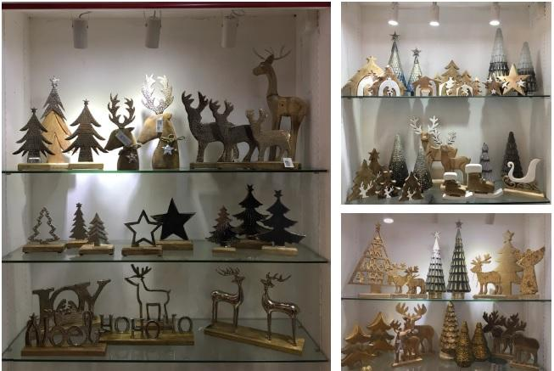
CHRISTMAS CREATIVE PRODUCTS

Slide 3
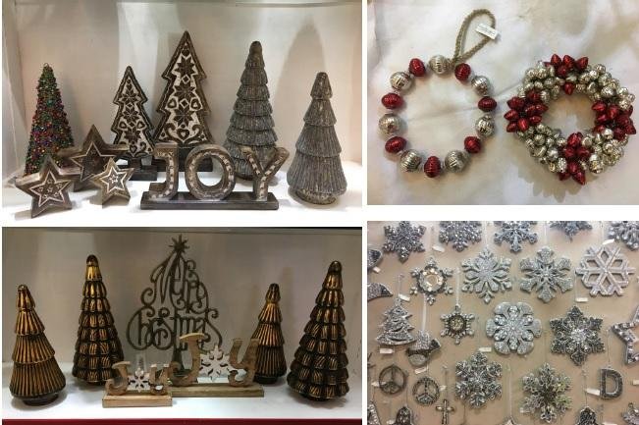
CHRISTMAS CREATIVE PRODUCTS

Slide 4
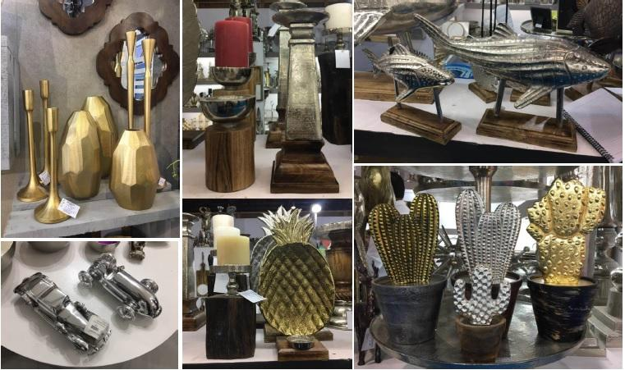
HOME DECOR

Slide 5
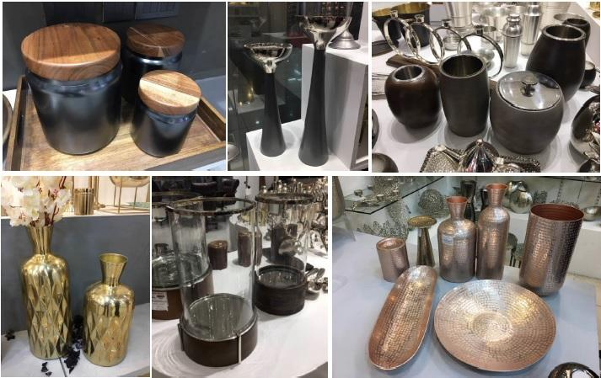
HOME DECOR

Slide 6
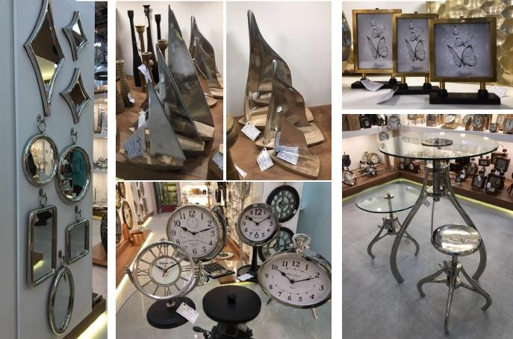
HOME DECOR

Slide 7
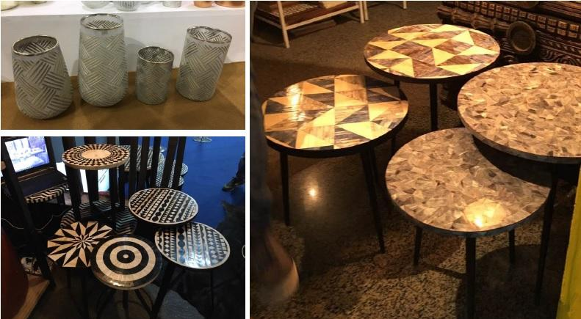
HOME DECOR

Slide 8
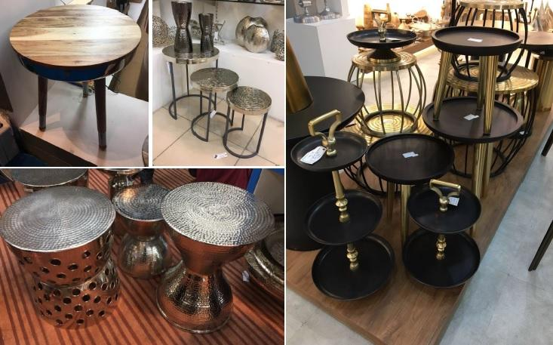
HOME DECOR

Slide 9
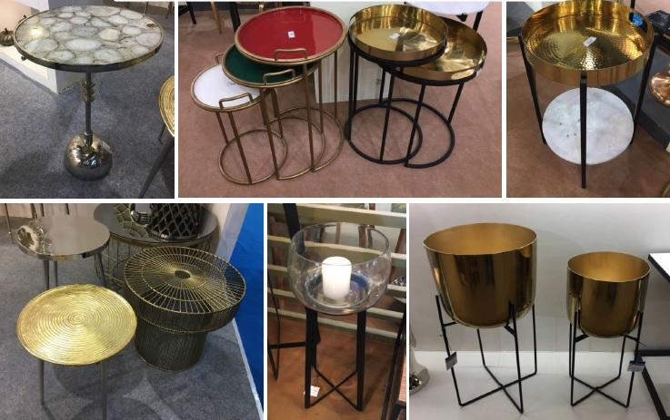
HOME DECOR

Slide 10
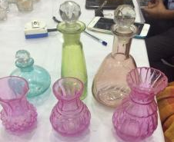
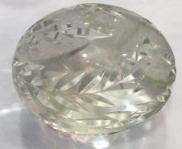
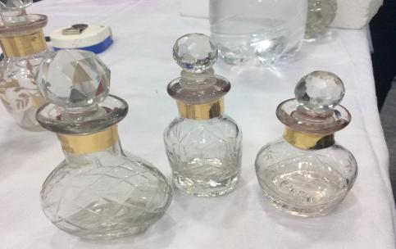
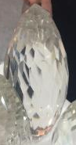
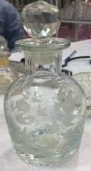
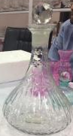
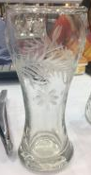
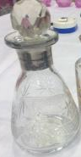
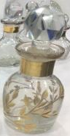
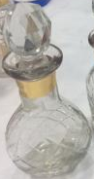
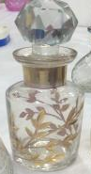
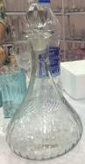
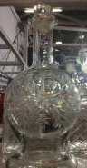
HOME DECOR

Slide 11
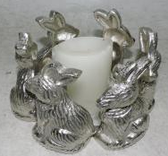
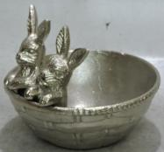
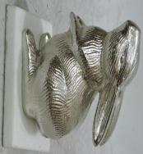
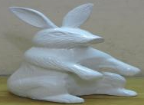
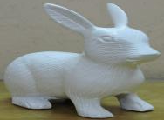
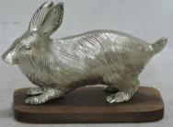
HOME DECOR
ITEM No. :16-666
SIZE (inches) :6.9x6.9x4.5
DESCRIPTION :DECORATIVE
MATERIAL : ALUMINUM
ITEM No. : 16-667
SIZE (inches) :8x8x7
DESCRIPTION :DECORATIVE
MATERIAL : ALUMINUM
ITEM No. :16-674
SIZE (inches) :6.5x4x4
DESCRIPTION :DECORATIVE
MATERIAL : ALUMINUM
ITEM No. : 16-675
SIZE (inches) :6.5x3.5x3.5
DESCRIPTION :DECORATIVE
MATERIAL : ALUMINUM
ITEM No. :16-680
SIZE (inches) :11.5x6.9x5
DESCRIPTION :DECORATIVE
MATERIAL : ALUMINUM
ITEM No. : 16-681
SIZE (inches) :9.5x9.25x4.5
DESCRIPTION :DECORATIVE
MATERIAL : ALUMINUM

Slide 12
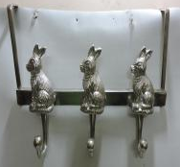
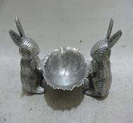
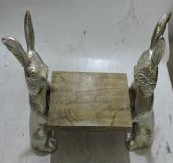
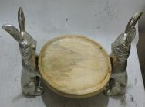
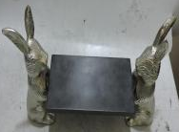
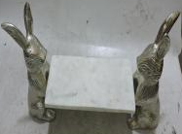
HOME DECOR
ITEM No. :16-648
SIZE (inches) :11x16x3
DESCRIPTION :DECORATIVE
MATERIAL : ALUMINUM
ITEM No. : 16-649
SIZE (inches) :7x5.9x12
DESCRIPTION :DECORATIVE
MATERIAL : ALUMINUM
ITEM No. :16-634
SIZE (inches) :18X9.25X4.9
DESCRIPTION :DECORATIVE
MATERIAL : ALUMINUM
ITEM No. :16-634
SIZE (inches) :18X9.25X4.9
DESCRIPTION :DECORATIVE
MATERIAL : ALUMINUM
ITEM No. :16-634
SIZE (inches) :18X9.25X4.9
DESCRIPTION :DECORATIVE
MATERIAL : ALUMINUM
ITEM No. :16-634
SIZE (inches) :18X9.25X4.9
DESCRIPTION :DECORATIVE
MATERIAL : ALUMINUM

Slide 13
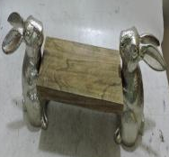
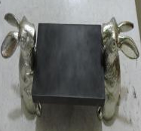
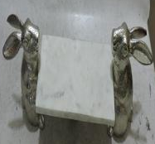
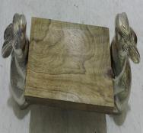
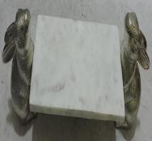
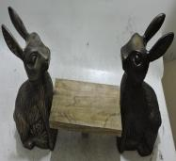
HOME DECOR
ITEM No. :16-635
SIZE (inches) :20X6X4.9
DESCRIPTION :DECORATIVE
MATERIAL : ALUMINUM
ITEM No. :16-635
SIZE (inches) :20X6X4.9
DESCRIPTION :DECORATIVE
MATERIAL : ALUMINUM
ITEM No. :16-635
SIZE (inches) :20X6X4.9
DESCRIPTION :DECORATIVE
MATERIAL : ALUMINUM
ITEM No. :16-640
SIZE (inches) :17.5X6X4.9
DESCRIPTION :DECORATIVE
MATERIAL : ALUMINUM
ITEM No. :16-640
SIZE (inches) :17.5X6X4.9
DESCRIPTION :DECORATIVE
MATERIAL : ALUMINUM
ITEM No. :16-643
SIZE (inches) :24X10X4.9
DESCRIPTION :DECORATIVE
MATERIAL : ALUMINUM

Slide 14
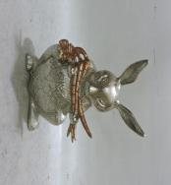
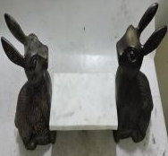
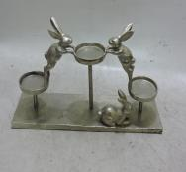
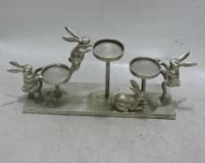
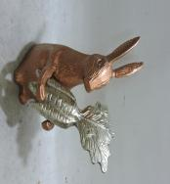
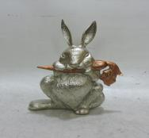
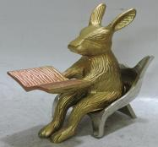
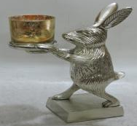
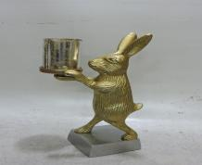
HOME DECOR
Item : 16-740
Size (inches) : 15.5x4.75x8.9
Description : Alum. Rabbit
ITEM No. :16-643
SIZE (inches) :24X10X4.9
DESCRIPTION :DECORATIVE
MATERIAL : ALUMINUM
Item : 16-755
Size (inches) :18.5x3.25x10.5
Description : Alum. Rabbit
Item : 16-756
Size (inches) : 22.5x9.5x5.5
Description : Alum. Rabbit
Item : 16-738
Size (inches) : 8.5x12x6.9
Description : Alum. Rabbit
Item : 16-743
Size (inches) :11x15.5x4.5
Description : Alum. Rabbit
Item : 16-749
Size (inches) :7.5x5x10.5
Description : Alum. Rabbit
Item : 16-745
Size (inches) :7.5x6.25x15
Description : Alum. Rabbit
Item : 16-745
Size (inches) :7.5x6.25x15
Description : Alum. Rabbit

Slide 15
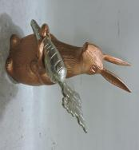
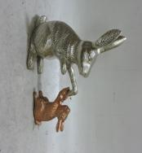







HOME DECOR
Item : 16-747
Size (inches) :17.5x11x7.5
Description : Alum. Rabbit
Item : 16-748
Size (inches) : 10.25x12x4
Description : Alum. Rabbit
Item : 16-906
Size (inches) :5x6.5x4
Description : Alum. Rabbit
Item : 16-911
Size (inches) :14x8.9x5.20
Description : Alum. Rabbit
Item : 16-915
Size (inches) : 9.5x9.25x4.25
Description : Alum. Rabbit
Item : 16-902
Size (inches) :6.5x5.75x4.9
Description : Alum. Rabbit
Item : 16-903
Size (inches) :6x6.25x4.9
Description : Alum. Rabbit
Item : 16-907
Size (inches) :5.9x4.9x6.5
Description : Alum. Rabbit
Item : 16-910
Size (inches) :6.5x4x4
Description : Alum. Rabbit

Slide 16







HOME DECOR
Item : 16-917
Size (inches) : 9.9x4.5x7.25
Description : Alum. Rabbit
Item : 16-916
Size (inches) :10x7.5x7.5
Description : Alum. Rabbit
Item No.# :-15-417
Description :- Aluminum Decorative Bird Holder
Size (Inches) :- 10.25x19x8.75 ”
@US$(FOB) :- $ 14.00
Item No.# :-15-662
Description :- Aluminum Decorative Rabbit
Item : 16-917
Size (inches) : 9.9x4.5x7.25
Description : Alum. Rabbit
Item No.# :-15-390
Description :- Aluminum Decorative Rabbit.
Size (Inches) :-5.75x4x3.25”
@US$(FOB) :- $ 3.00
Item No.# :-15-661
Description :- Aluminum Decorative Rabbit

Slide 17





HOME DECOR
6255 – Wall Wreath
3755 – Milagro Hearth Hanging Ornament
3780 – Jeweled Milagro Hearth Hanging Ornament
2632 – Glass Dome W/Base W/Inside Milagro Decoration
6254 – Wall Wreath
3648 – Milagro Heart On Stand

Slide 18





HOME DECOR
1620 – Milagro Hearth Hanging Ornament
1618 – Milagro Heart Hanging Ornament
6256 – Butterfly Wall Wreath
LAM-0333
5621 – T-lite Holder
4395 – Wall Wreath
1617 – Milagro Hearth Hanging Ornament
3705 – Flower and Leaf Wreath Mirror

Slide 19








HOME DECOR
TMR-0184 – Sand Timer W/Box
SUN-0112 – Sundial W/Leather Box
CLK-0199 – 3 Inch Table Clock Brass
26411 – Wreath
TMR-0184 – Sand Timer W/Box
MIS-0846 – Royal Key Bottle Opener Brass
FAN-0012 – Small Brass Fan Leather Sheathed
26509 – Flower Stick

Slide 20








HOME DECOR
BHBD-0029 – Carved Wooden Bookend Dist. Grey
BHWS-0307 – Carved Wall Shelf Dist. White
BHTY-0169 – Set of 2 Carved Trays (Nested)
MSVT19-04 – Man Style Scissor
BHBD-0044 – Carved Wooden Bookend Dist. White
BHWA-0316 – Carved Wall Shelf Dist. Grey
BHWS-1143 – Carved Wall Shelf Dist. White
MSVT19-05 – Door Handle Brass

Slide 21



HOME DECOR
MSVT19-06 – Key Ring W/Bottle Opener
MSVT19-08 – Owl Door Knocker
MSVT19-07 – Locks

Slide 22
HOME DECOR
BHWS-0307 – Carved Wall Shelf Dist. White
BHTY-0169 – Set of 2 Carved Trays (Nested)
MSVT19-04 – Man Style Scissor
BHWA-0316 – Carved Wall Shelf Dist. Grey
BHWS-1143 – Carved Wall Shelf Dist. White
MSVT19-05 – Door Handle Brass

Slide 23




HOME DECOR
Item No. : 19-1566
Size (inch) :10x9.5x6.5
Material : Aluminum
Item No. : 19-1567
Size (inch) :15.5x11.5x11.5
Material : Aluminum
Item No. : 19-1568
Size (inch) :15x12x11
Material : Aluminum
Item No. : 19-1569
Size (inch) :22x14x14
Material : Aluminum
Item No. : 19-1570
Size (inch) :22x14x14
Material : Aluminum
Item No. : 19-1571
Size (inch) :11x9.5x3
Material : Aluminum
Item No. : 19-1564
Size (inch) :12x9.5x19.5
Material : Aluminum
Item No. : 19-1565
Size (inch) :12x12x7
Material : Aluminum

Slide 24







HOME DECOR
Item No. : 19-1572
Size (inch) :11.5x10x4
Material : Aluminum
Item No. : 19-1573
Size (inch) :15.5x13.5x13.5
Material : Aluminum
Item No. : 19-1574
Size (inch) :10x4x4
Material : Aluminum
Item No. : 19-1575
Size (inch) :12x5x5
Material : Aluminum
Item No. : 19-1576
Size (inch) :12x5x5
Material : Aluminum
Item No. : 19-1577
Size (inch) :13.5x5x5
Material : Aluminum
Item No. : 19-1578,1579
Size (inch) :15.5x5x5
12.5x5x5
Material : Aluminum
Item No. : 19-1580
Size (inch) :13x4.25x4.25
Material : Aluminum
Item No. : 19-1587 , 1588 , 1589
Size (inch) :16x5x5 , 14x5x5x , 12x5x5
Material : Aluminum
Item No. : 19-1590 , 1591
Size (inch) :11.25x4x4 , 7.5x4x4
Material : Aluminum
Item No. : 19-1594
Size (inch) :8x3.5x3.5
Material : Aluminum

Slide 25


HOME DECOR
Item No. : 19-1609 , 1610
Size (inch) : 24x11x4.5 , 20x12x12
Material : Aluminum
Item No. : 19-1595 , 1596
Size (inch) : 9.5x3x3 , 7.25x3x3
Material : Aluminum

Slide 26







HOME DECOR
ESR-2017-03 – Wire Stick With Flower
VTC-01 – 4-Light C/Holder
VTC-01 – 4-Light C/Holder
85635-A/85635-B – Hanging Heart S/2
80530 – Hanging C/Holder Wreath
42044 – Hanging Hook With Flower
88412/88415/VTC-02 – Candle Stick

Slide 27




HOME DECOR
40401 – Hanging Decorative
40407 – Hanging Decorative
76198 – Hanging Decorative
23981-A – Hanging Decorative

Slide 28





HOME DECOR
IR673 – Decorative Christmas Tree Large
IR674 – Decorative Christmas Tree Small
IR091 – Decorative Christmas Tree
IR743 – Decorative Candle Holder 5 Arms
IR616 – Decorative Candle Holder Single Head

Slide 29












HOME DECOR
IR786 – Decorative Candle Holder Single Head
IR648 –
Decorative Wreath For Wall
IR068 – Decorative Wreath For Wall
IR070 – Decorative Wreath For Wall
IR042 – Decorative Wreath For Wall Heart Shaped
IR237 – Decorative Wall Hanger 4 Hooks
7427 - Flower
5660 – Ball Ornament
6118 – Decor
6119 - Decor
6214 – Candle Holder

Slide 30







HOME DECOR
6215 – Candle Holder
6216 – Candle Holder
3287 - Wreath
7747-R/7747-G/7747-BL – Glass Heart Ornament
3420 – Pillar Holder
7425 – Wreath On Stand
3230-B - Staircase

