Slide 1

ESS ELL SOURCING CO.

Slide 2
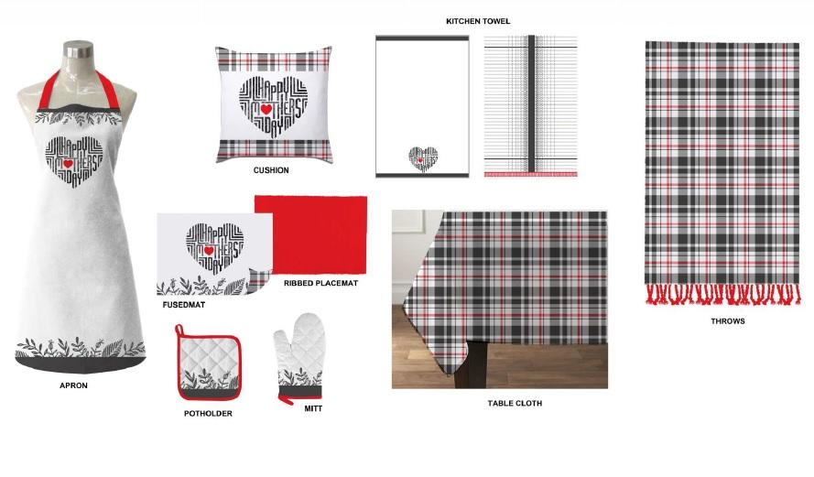

KITCHEN & TABLE LINEN

Slide 3
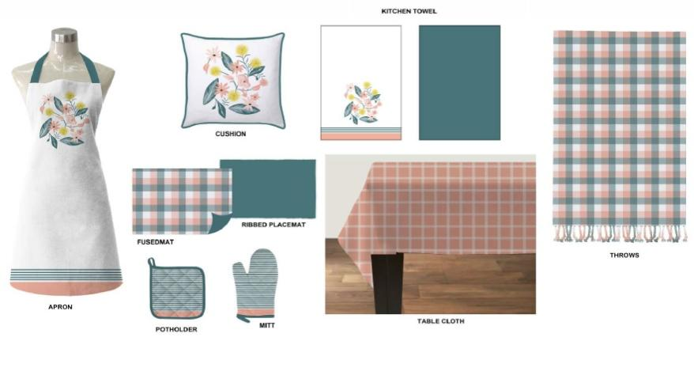
KITCHEN & TABLE LINEN

Slide 4
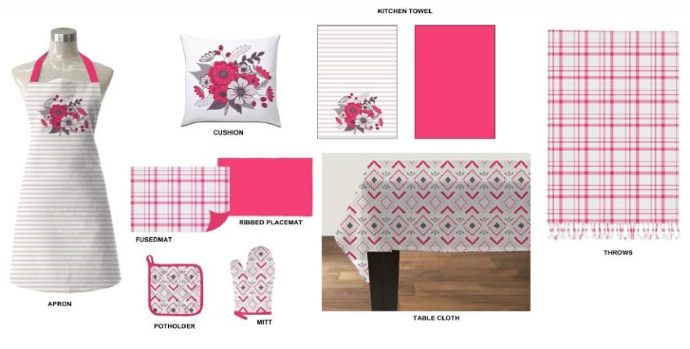
KITCHEN & TABLE LINEN

Slide 5
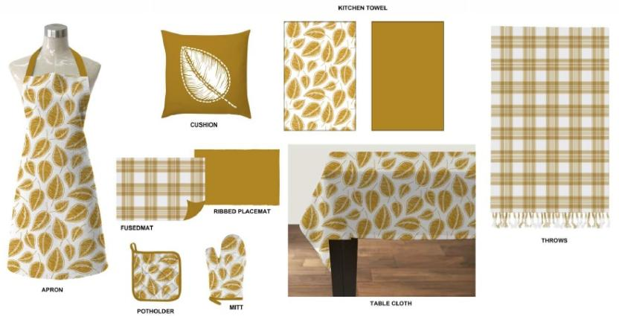
KITCHEN & TABLE LINEN

Slide 6
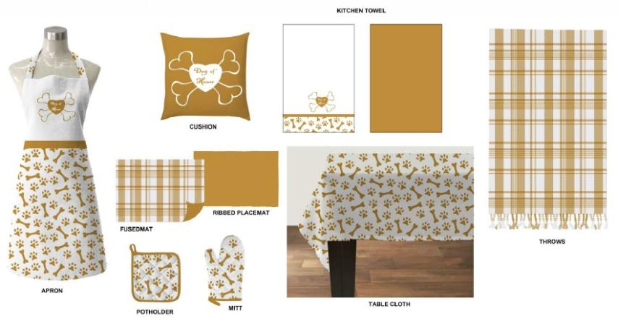
KITCHEN & TABLE LINEN

Slide 7
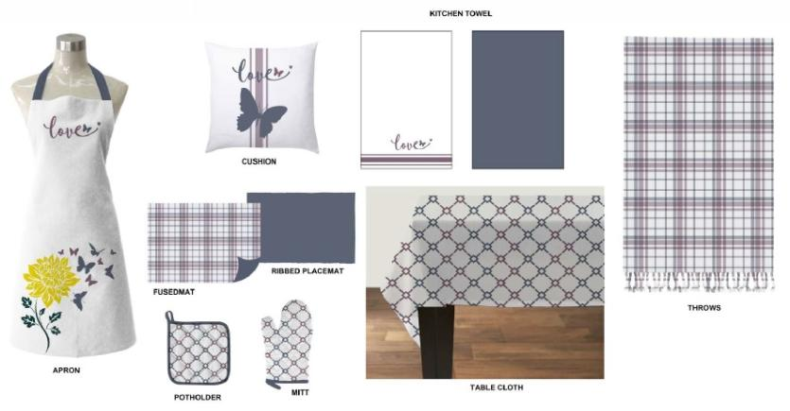
KITCHEN & TABLE LINEN

Slide 8
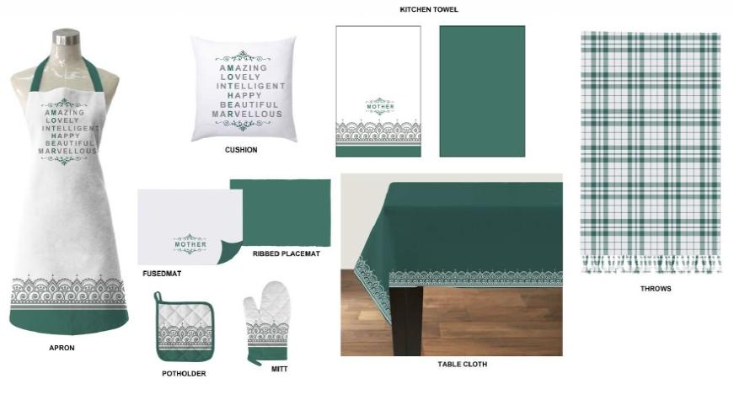
KITCHEN & TABLE LINEN

Slide 9
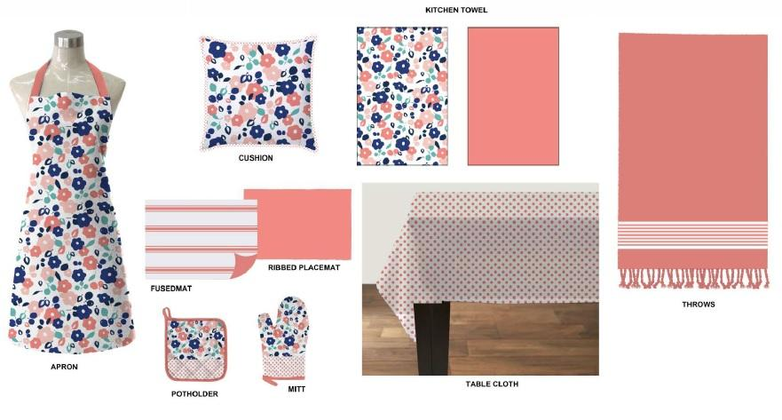
KITCHEN & TABLE LINEN

Slide 10
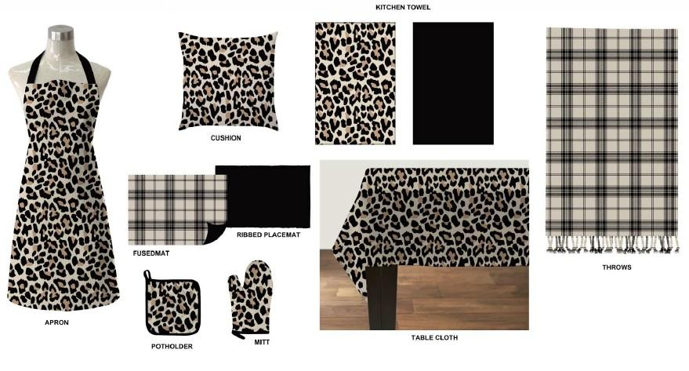
KITCHEN & TABLE LINEN

Slide 11
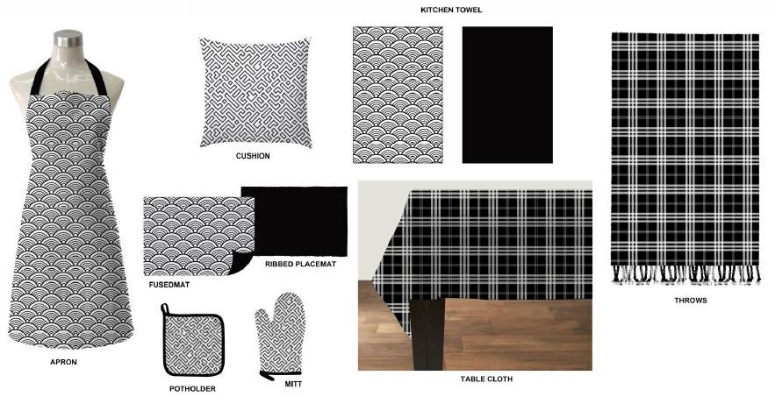
KITCHEN & TABLE LINEN

Slide 12
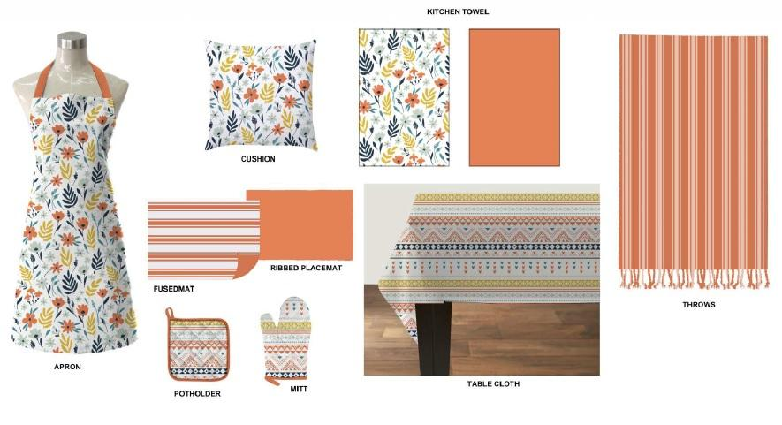
KITCHEN & TABLE LINEN

Slide 13
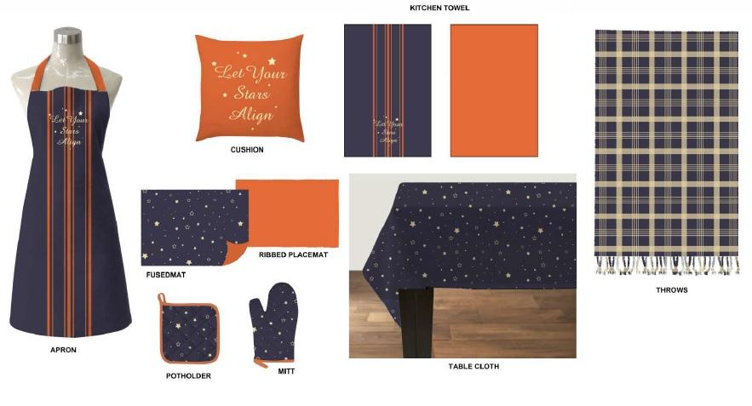
KITCHEN & TABLE LINEN

Slide 14
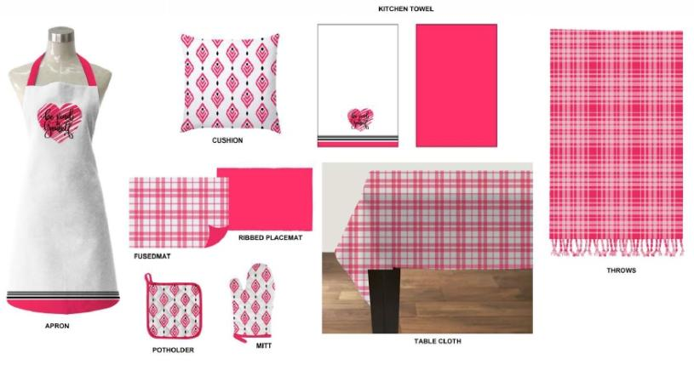
KITCHEN & TABLE LINEN

Slide 15
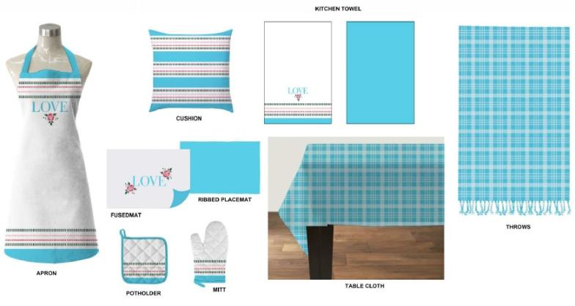
KITCHEN & TABLE LINEN

Slide 16
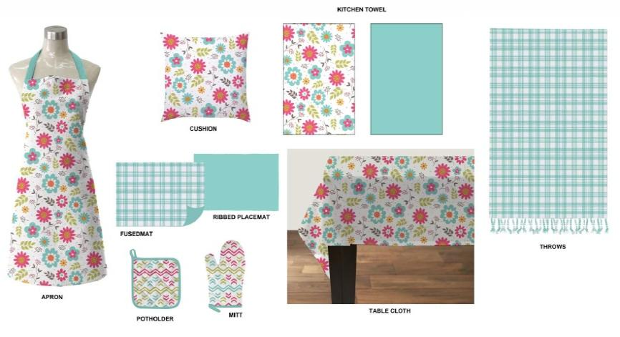
KITCHEN & TABLE LINEN

Slide 17
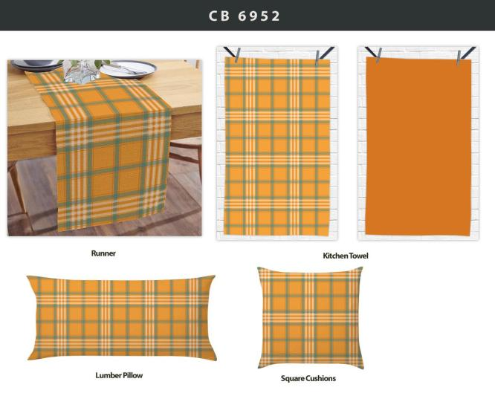
KITCHEN & TABLE LINEN

Slide 18
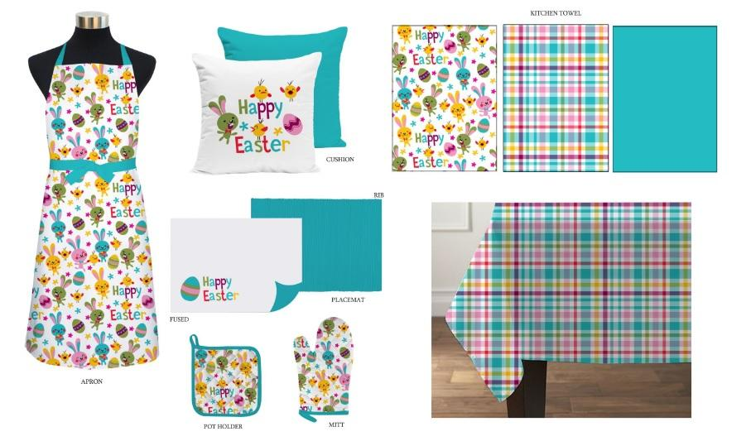
KITCHEN & TABLE LINEN

Slide 19
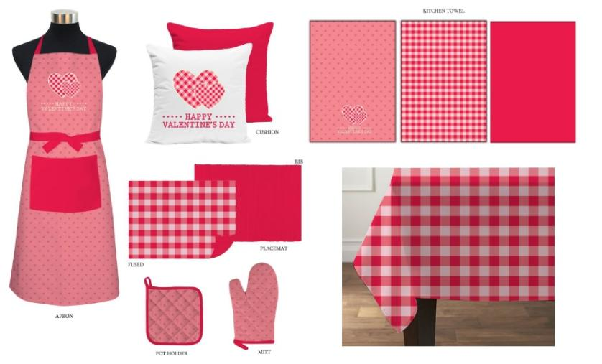
KITCHEN & TABLE LINEN

Slide 20
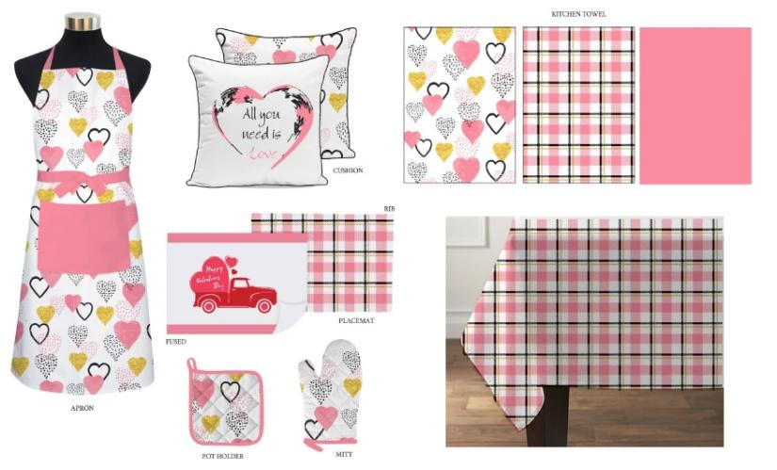
KITCHEN & TABLE LINEN

Slide 21
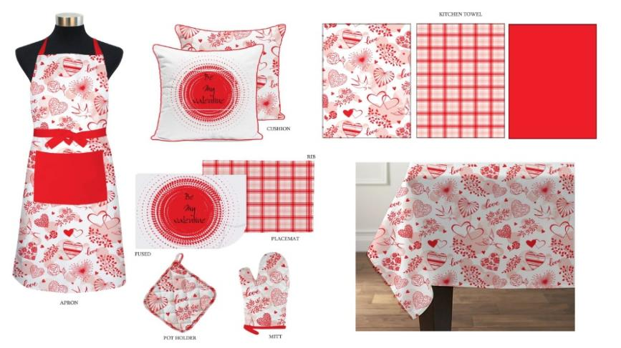
KITCHEN & TABLE LINEN

Slide 22
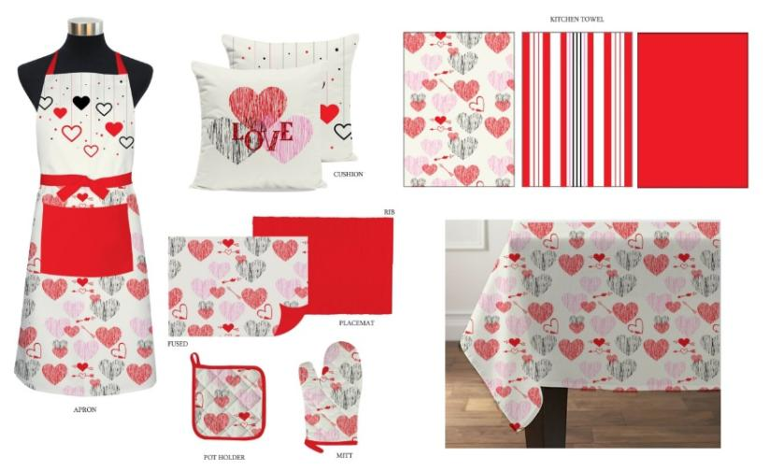
KITCHEN & TABLE LINEN

Slide 23
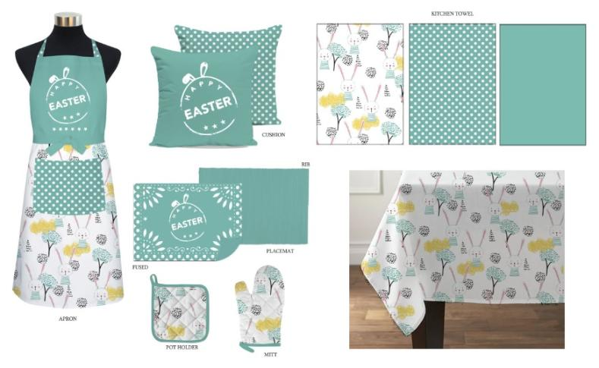
KITCHEN & TABLE LINEN

Slide 24
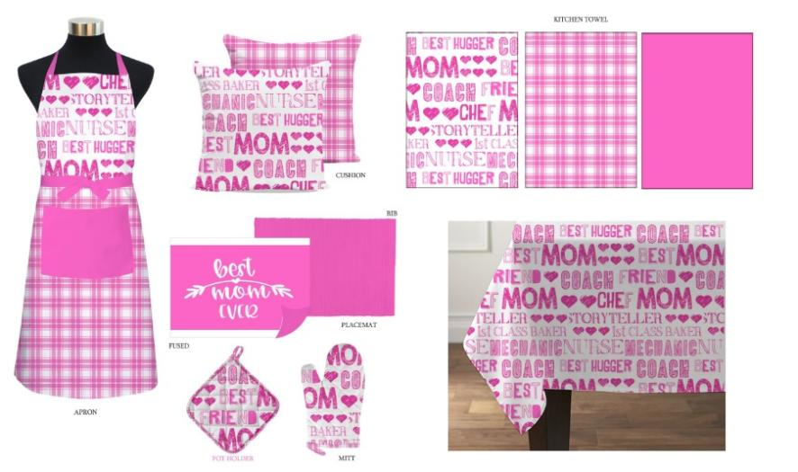
KITCHEN & TABLE LINEN

